Slide 1
Operating systems
Lecture #3

Slide 2
Content Lecture#3
01
I
02
P
03
C
04
O
05
P
06
P
07
P
08
P
09
P
10
Z

Slide 3
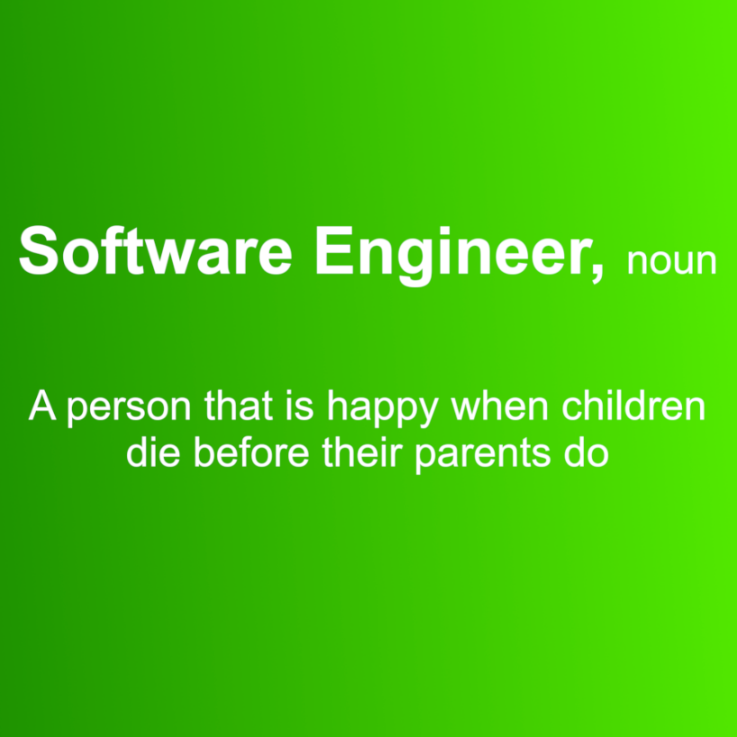
Lets take a Break

Slide 4
Revising Previous Lecture
Important System Calls Used in OS
fork()
Processes use this system call to create processes that are a copy of themselves. With the help of this system Call parent process creates a child process, and the execution of the parent process will be suspended till the child process executes.
exec()
This system call runs when an executable file in the context of an already running process that replaces the older executable file. However, the original process identifier remains as a new process is not built, but stack, data, head, data, etc. are replaced by the new process.
exit():
The exit() system call is used to terminate program execution. Specially in the multi-threaded environment, this call defines that the thread execution is complete. The OS reclaims resources that were used by the process after the use of exit() system call.
kill():
The kill() system call is used by OS to send a termination signal to a process that urges the process to exit. However, a kill system call does not necessarily mean killing the process and can have various meanings.
wait()
In some systems, a process needs to wait for another process to complete its execution. This type of situation occurs when a parent process creates a child process, and the execution of the parent process remains suspended until its child process executes.
The suspension of the parent process automatically occurs with a wait() system call. When the child process ends execution, the control moves back to the parent process.

Slide 5
Scheduling
process scheduling, is the basis for multi programmed operating systems, Objective of maximum CPU utilization obtained with multiprogramming
Exec()
the program specified in the parameter to exec() will replace the entire process including thread

Slide 6
Scheduling
Scheduler
The scheduler is part of the operating system, concerned with which process to run next if multiple run-able processes are in ready queue
Scheduler is concerned with deciding on policy, not providing a mechanism
It is important because it can have a big effect on resource utilization and overall performance of the system
Scheduling Algorithm
In a multiprogramming computer several processes will compete for use of the processor
At any time only one process will be running while other will wait for process to be free
Scheduling algorithm is logic that determines the order in which processes should run when multiple processes are there
The aim of process scheduling is to achieve objectives such as maximum CPU utilization and to improve its performance

Slide 7
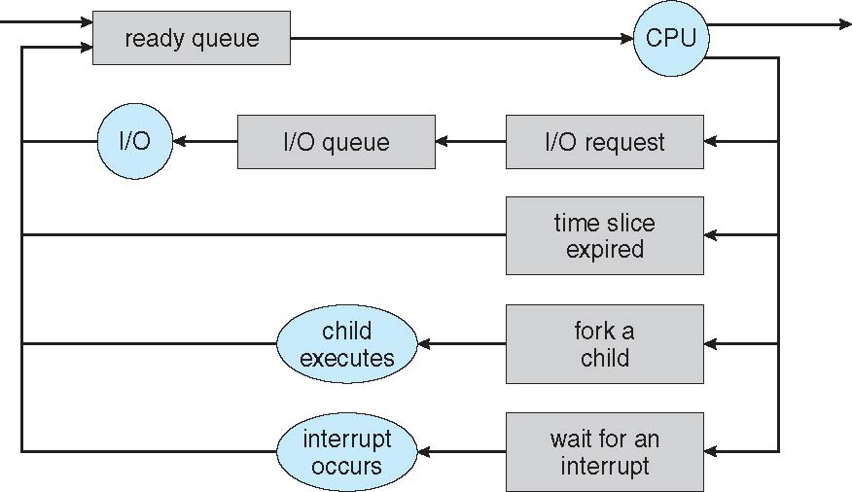
Scheduling

Slide 8
Process Scheduling
Maximum CPU utilization obtained with multiprogramming
CPU–I/O Burst Cycle – Process execution consists of a cycle of CPU execution and I/O wait
CPU burst followed by I/O burst
CPU burst distribution is of main concern
Objective
Max CPU utilization
Max throughput
Min turnaround time
Min waiting time
Min response time

Slide 9
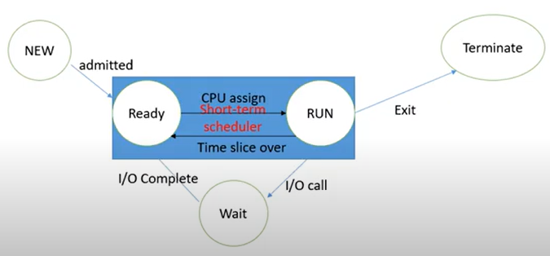
CPU Scheduler
Short-term scheduler selects from among the processes in ready queue, and allocates the CPU to one of them work for READY and RUN
Queue may be ordered in various ways
CPU scheduling decisions may take place when a process:
Switches from running to waiting state
Switches from running to ready state
Switches from waiting to ready
Terminates
Scheduling under 1 and 4 is non-preemptive
All other scheduling is preemptive
Consider access to shared data
Consider preemption while in kernel mode
Consider interrupts occurring during crucial OS activities

Slide 10
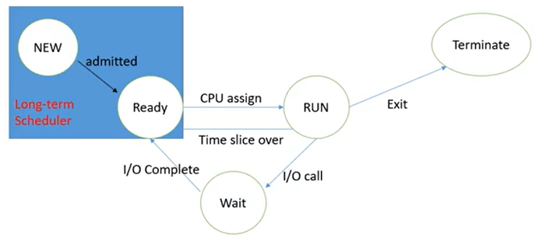
CPU Scheduler
Long-term scheduler bring the processes in ready queue, and work for NEW and Ready

Slide 11
Dispatcher
Dispatcher module gives control of the CPU to the process selected by the short-term scheduler; this involves:
switching context
switching to user mode
jumping to the proper location in the user program to restart that program
Dispatch latency
time it takes for the dispatcher to stop one process and start another running

Slide 12
Scheduling Criteria/Objective
CPU utilization
keep the CPU as busy as possible
Throughput
# of processes that complete their execution per time unit
Turnaround time
amount of time to execute a particular process
Waiting time
amount of time a process has been waiting in the ready queue
Response time
amount of time it takes from when a request was submitted until the first response is produced, not output (for time-sharing environment)
Class
Class of job, i.e. batch or on-line or real-time
Resource requirements
E.g. expected run time, memory required, etc
I/O or CPU bound
i.e. whether job is I/O bound or CPU bound
Resources used to date
i.e. the amount of processor time already consumed
Waiting time to date
i.e. the amount of time spent waiting for service so far
Priority
Priority assigned to that process or job

Slide 13
Command line argument
In order to implement command line arguments, generally, 2 parameters are passed into the main function:
Number of command line arguments
The list of command line arguments
The basic syntax is
int main( int argc, char *argv[] )
{
.
.
// BODY OF THE MAIN FUNCTION
.
.
}
argc: It refers to “argument count”. It is the first parameter that we use to store the number of command line arguments. It is important to note that the value of argc should be greater than or equal to 0.
agrv: It refers to “argument vector”. It is basically an array of character pointer which we use to list all the command line arguments.
https://www.onlinegdb.com/online_c_compiler#
// The program name is cl.c
#include<stdio.h>
int main(int argc, char** argv)
{
printf("Hello World!\n\n");
int i;
printf("The number of arguments are: %d\n",argc);
printf("The arguments are:");
for ( i = 0; i < argc; i++)
{
printf("%s\n", argv[i]);
}
return 0;
}

Slide 14
Exec()
Fork(): system call is used to create separate, duplicate process.
Exec() the program specified in the parameter to exec() will replace the entire process including thread
int execl(char const *path, char const *arg0, ...);
int execle(char const *path, char const *arg0, ..., char const *envp[]);
int execlp(char const *file, char const *arg0, ...);
int execv(char const *path, char const *argv[]);
int execve(char const *path, char const *argv[], char const *envp[]);
int execvp(char const *file, char const *argv[]);
int fexecve(int fd, char *const argv[], char *const envp[]);
Path: The argument specifies the path name of the file to execute as the new process image. Arguments beginning at arg0 are pointers to arguments to be passed to the new process image. The argv value is an array of pointers to arguments.
arg0: The first argument arg0 should be the name of the executable file. Usually it is the same value as the path argument. Some programs may incorrectly rely on this argument providing the location of the executable, but there is no guarantee of this nor is it standardized across platforms.
envp: Argument envp is an array of pointers to environment settings. The exec calls named ending with an e alter the environment for the new process image by passing a list of environment settings through the envp argument. This argument is an array of character pointers; each element (except for the final element) points to a null-terminated string defining an environment variable.

Slide 15
Exec()
e: It is an array of pointers that points to environment variables and is passed explicitly to the newly loaded process.
l: l is for the command line arguments passed a list to the function
p: p is the path environment variable which helps to find the file passed as an argument to be loaded into process.
v: v is for the command line arguments. These are passed as an array of pointers to the function.
Execl() the calling process will be replaced with the new program where l represent list of parameters
Code segment , data segment, heap and stack will be replaced. With the new program
First argument is the path of the file.
Second till end are rguments
To Terminate pass NULL
int excel(const char * path, ) l is list of parameters.

Slide 16
Lab
Run Command Line Argument
Create a Process with EXEC()

Slide 17
Thank you

